Slide 1
HackFrost 4.0 Boreal Automated Drilling
Team B.A.D.

Slide 2
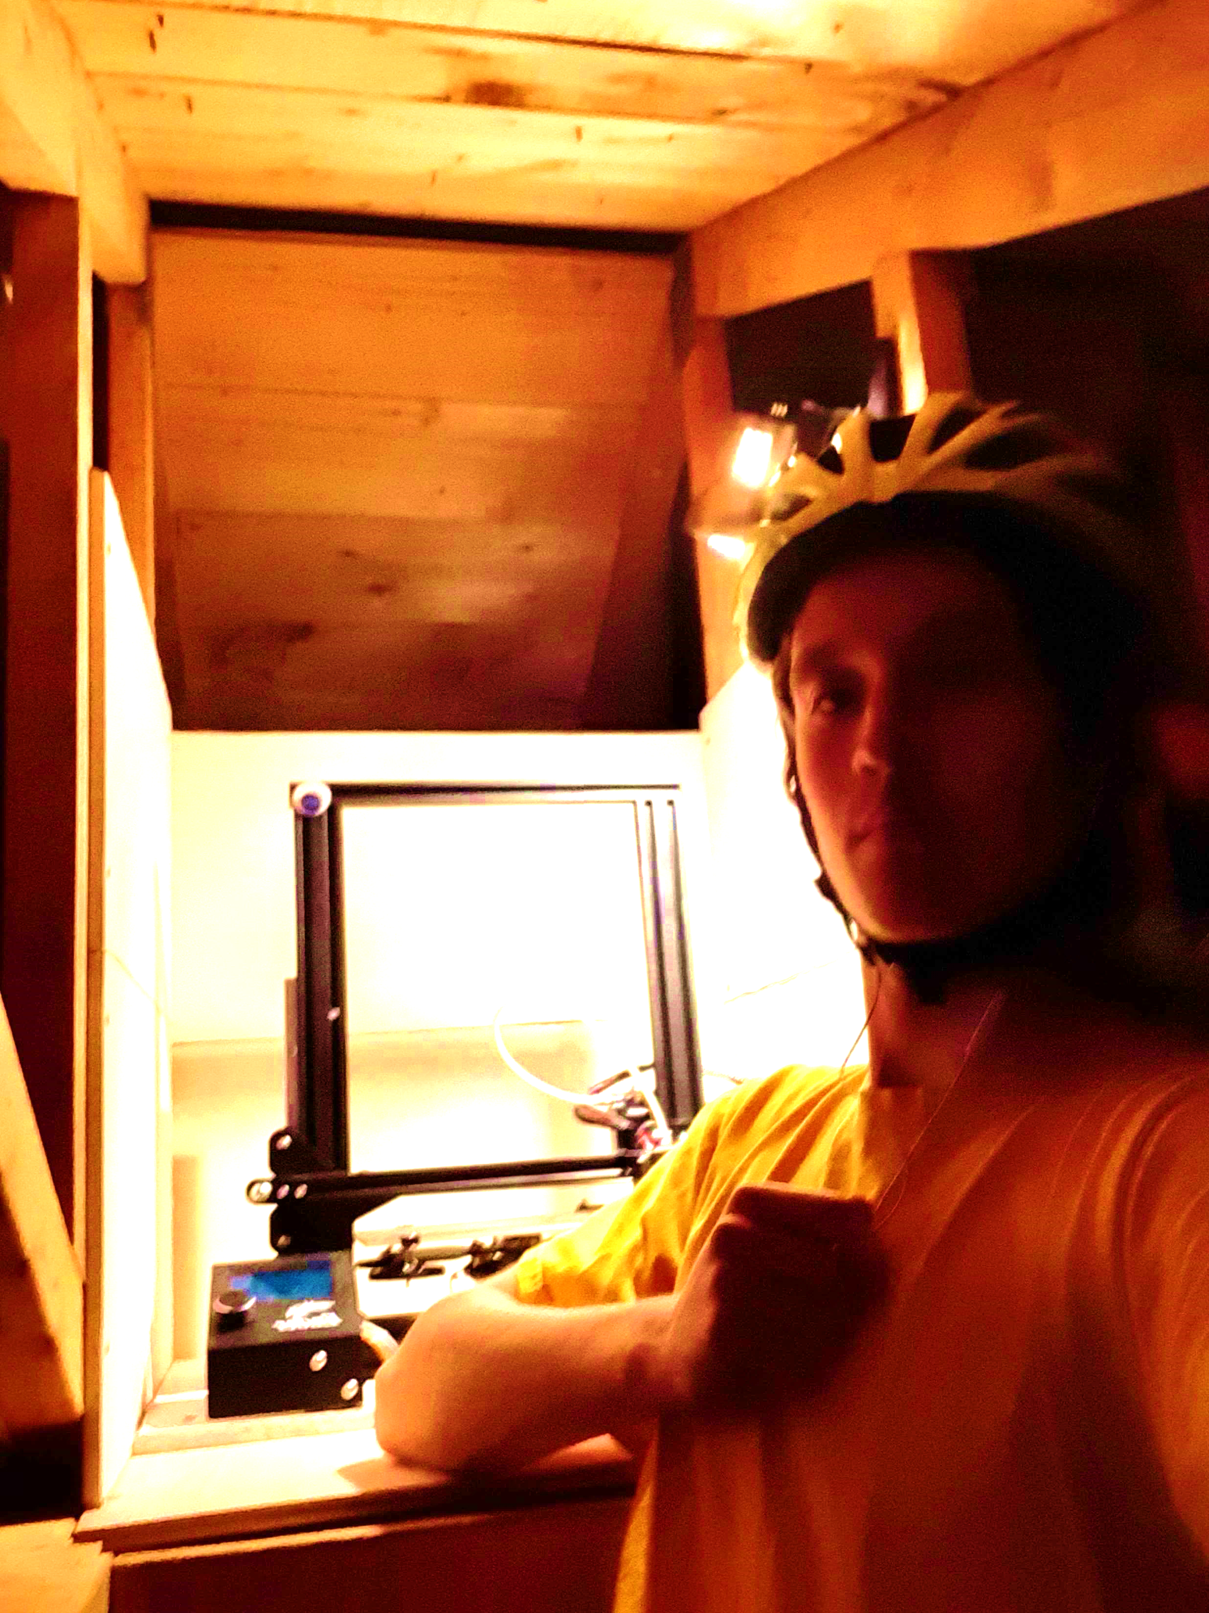
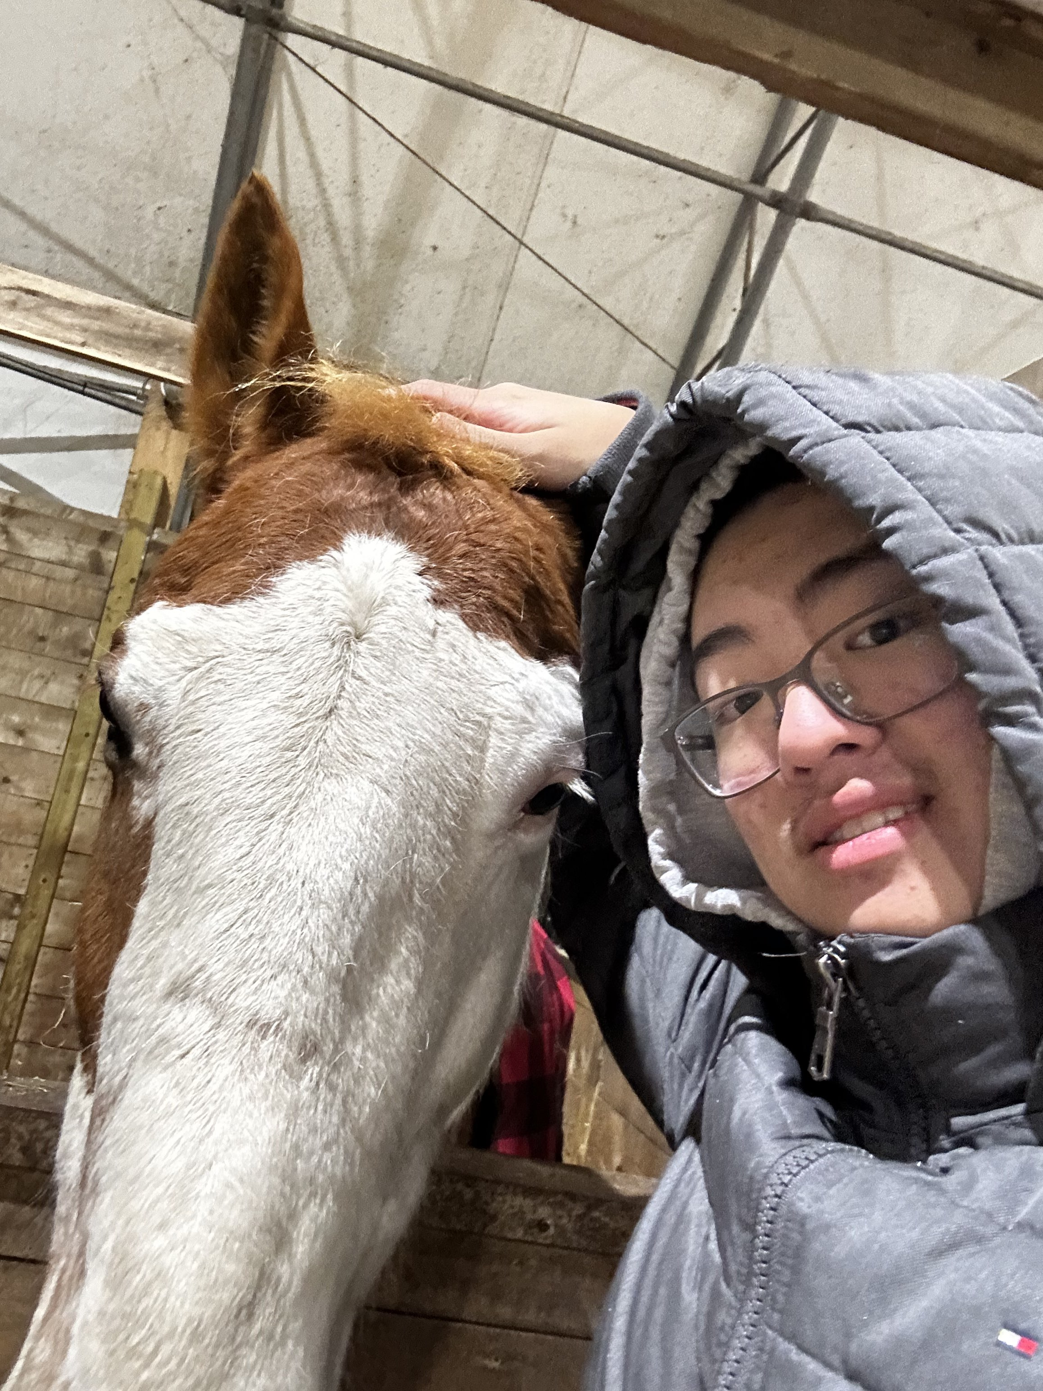

Team B.A.D.
Brendan Booth
Abner Zheng
Dipayan Dhar

Slide 3
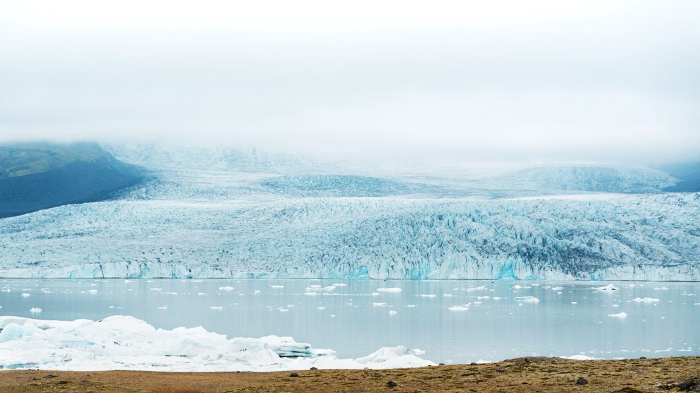
$276 billion
Spent on repairing infrastructure damge from permafrost thaw
~1400 gigatons
Of greenhouse gases remain frozen within permafrost

Slide 4
Our Solution:
BoreBot! An autonomous solar-powered robot that obtains permafrost data from different arctic communities.

Slide 5
Prototype
BoreBot uses its metal probe to obtain data on permafrost depth, temperature, and soil type
This data will be used for prospecting future roads and building locations.
BoreBot is a much more efficient and rigorous method of data collection.
Features
Solar Powered
Large battery capacity
Real-time pathfinding algorithm utilizing waypoints
Accurate telemetry data
Utilizes a modified version of Ardurover
Easily replaceable parts in case of damage/wear
Open-Source Project
Estimated Cost: 1700$

Slide 6


Linking to Our Database
Data Collection
Graph Depth and Temperature
Data
Develop Geographical Map

Slide 7
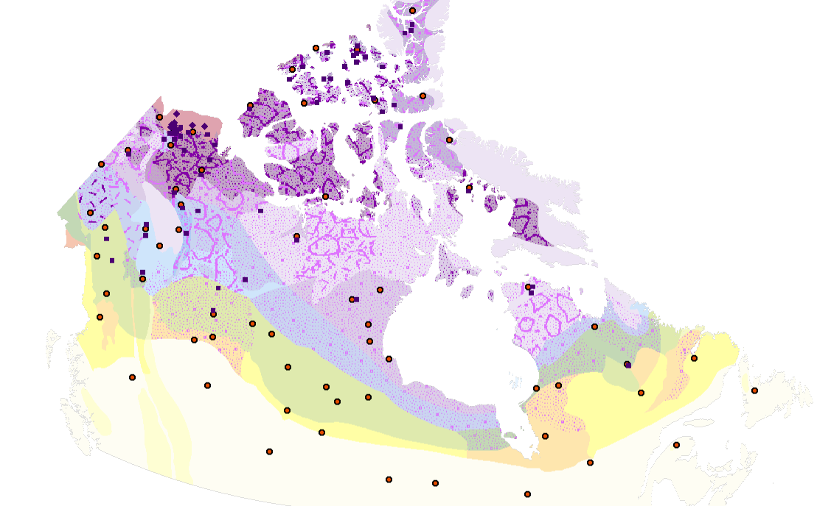
Database Mockup
Users have the option to contribute to our open-source database.
This data is displayed on a public website.
Practical method of obtaining general information about the permafrost.
Notes:
Accurate permafrost measurement data allows for informed decision-making for climate change adaptation strategies, and enhances safety by identifying unstable ground conditions.
Areas that are vulnerable to permafrost thawing are effectively identified.

Slide 8
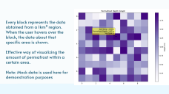

Slide 9
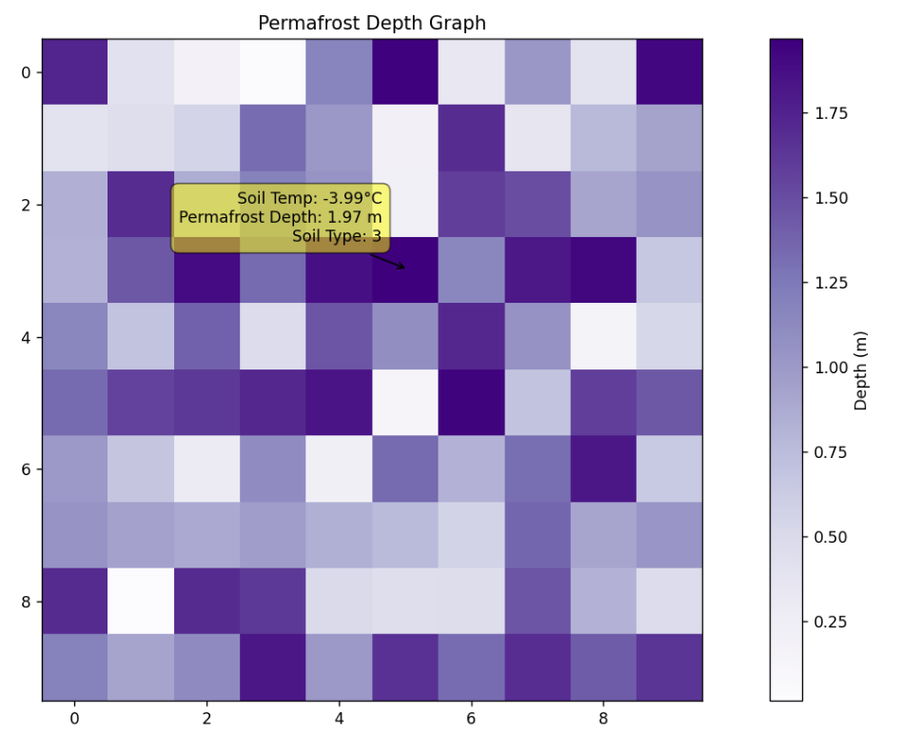
Every block represents the data obtained from a 1km² region. When the user hovers over the block, the data about that specific area is shown.
Effective way of visualizing the amount of permafrost within a certain area.
Note: Mock data is used here for demonstration purposes

Slide 10
Implementation
We will implement this into arctic communities by marketing towards:
- Government/Environmental Organizations
- Surveying Professionsals
- Engineering/Construction Firms
- Educational Institutes
Community Engagement:
- Permafrost monitoring project in communities
- Government/NPO collaboration with research projects
- Incorporate traditional practices of Indigenous communities
- Educational outreach programs
- Encorporate into isolated communities

Slide 11



Current Competitors:

Slide 12
Future Developments
Accurate permafrost measurement data allows for informed decision-making for climate change adaptation strategies, and enhances safety by identifying unstable ground conditions.
Areas that are vulnerable to permafrost thawing are effectively identified.
Use pre-existing data to estimate the change of permafrost over time, using a Neural Network
Advanced remote sensing technologies

Slide 13
Thanks!

